Slide 1

Welcome Back

Slide 2
54631
16415
315
1124
56466
19872
76769
6231
28134
1481
64142

Slide 3
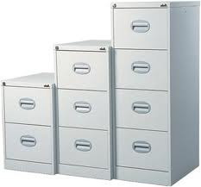
Arrays….

Slide 4
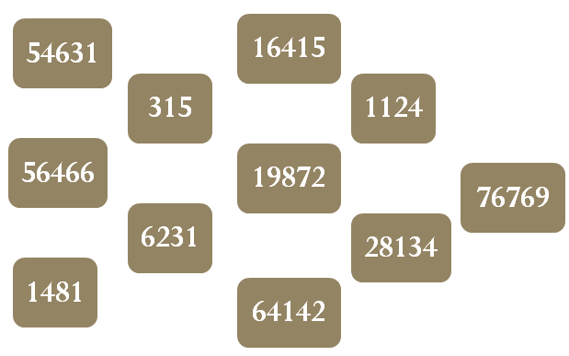
1
2
3
4
5
6
7
8
9
10
11
54631
0
1
2
3
4
5
6
7
8
9
10
56466
1481
315
6231
16415
19872
64142
1124
28134
76769

Slide 5
Index vs. Value

Slide 6
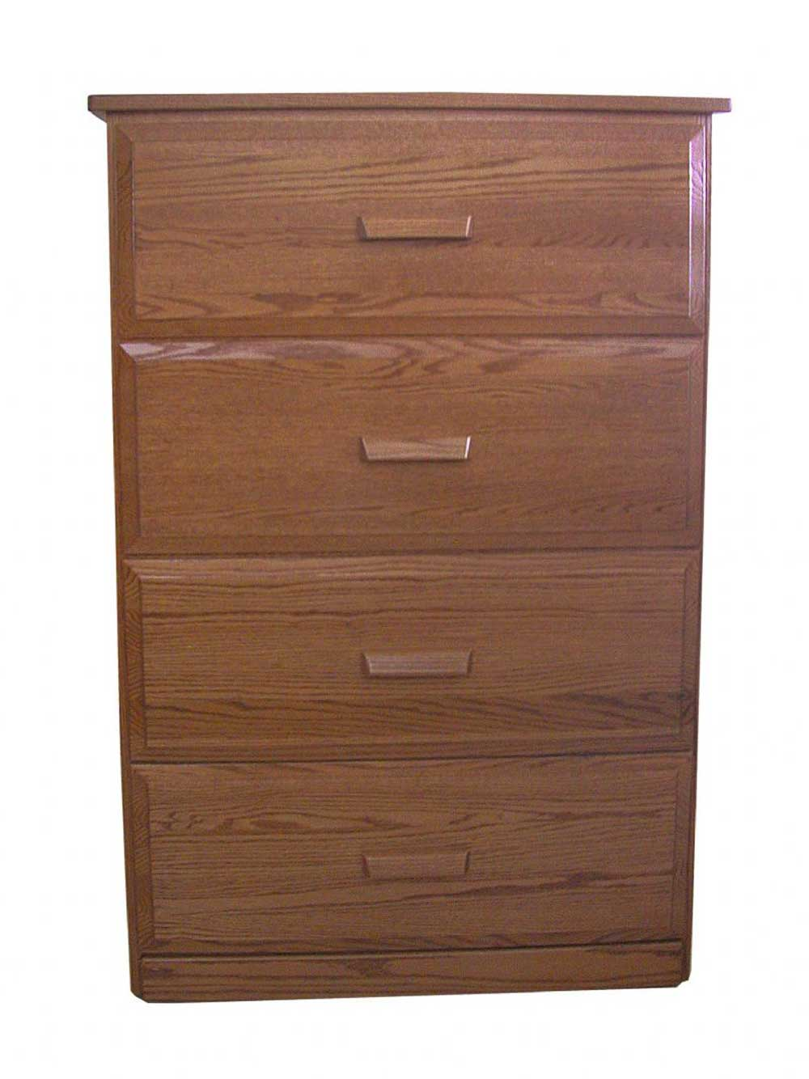
0
1
2
3

Slide 7
How To
Deal with Arrays ?

Slide 8
Declaration
...
…
-184
54894
35146
-4686
-468
...
…
…
DataType ArrayName[SizeOfArray];
0
1
2
3
4
myNumber[5]
int myNumbers[5];

Slide 9
Initialization
...
…
31
22
31
4
2
...
…
…
int myNumbers[5] = { 31, 22, 31 , 4 , 2 };
0
1
2
3
4
myNumber[5]

Slide 10
...
…
1.2
2.7
3
0
0
...
…
…
float myNumbers[5] = { 1.2, 2.7, 3 };
0
1
2
3
4
myNumber[5]

Slide 11

Let’s Play
with Arrays!!

Slide 12
int main()
{
return 0;
}
int arr[5] = { 7, 12, 2};
arr[3] = 8;
arr[4] = 1;
cout << arr[0] << endl;
cout << arr[2] << endl;

Slide 13
int main()
{
return 0;
}
...
…
7
12
2
0
0
...
…
…
int arr[5] = { 7, 12, 2};
arr[3] = 8;
arr[4] = 1;
cout << arr[0] << endl;
cout << arr[2] << endl;
0
1
2
3
4
myNumber[5]

Slide 14
int main()
{
return 0;
}
...
…
7
12
2
8
0
...
…
…
int arr[5] = { 7, 12, 2};
arr[3] = 8;
arr[4] = 1;
cout << arr[0] << endl;
cout << arr[2] << endl;
0
1
2
3
4
myNumber[5]

Slide 15
int main()
{
return 0;
}
...
…
7
12
2
8
1
...
…
…
int arr[5] = { 7, 12, 2};
arr[3] = 8;
arr[4] = 1;
cout << arr[0] << endl;
cout << arr[2] << endl;
0
1
2
3
4
myNumber[5]

Slide 16
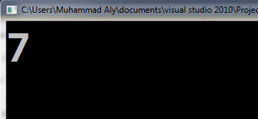
int main()
{
return 0;
}
int arr[5] = { 7, 12, 2};
arr[3] = 8;
arr[4] = 1;
cout << arr[0] << endl;
cout << arr[2] << endl;
...
…
7
12
2
8
1
0
1
2
3
4

Slide 17
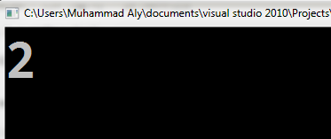
int main()
{
return 0;
}
int arr[5] = { 7, 12, 2};
arr[3] = 8;
arr[4] = 1;
cout << arr[0] << endl;
cout << arr[2] << endl;
...
…
7
12
2
8
1
0
1
2
3
4

Slide 18
int main()
{
return 0;
}
int arr[3] ;
arr[1] = 2;
arr[2] = 8;
arr[3] = 1;
cout << arr[1] << endl;
cout << arr[2] << endl;
cout << arr[3] << endl;

Slide 19
int main()
{
return 0;
}
int arr[3] ;
arr[1] = 2;
arr[2] = 8;
arr[3] = 1;
cout << arr[1] << endl;
cout << arr[2] << endl;
cout << arr[3] << endl;
Crash

Slide 20
int main()
{
return 0;
}
int arr[3] ;
arr[1] = 2;
arr[2] = 8;
cout << arr[1] << endl;
cout << arr[2] << endl;

Slide 21
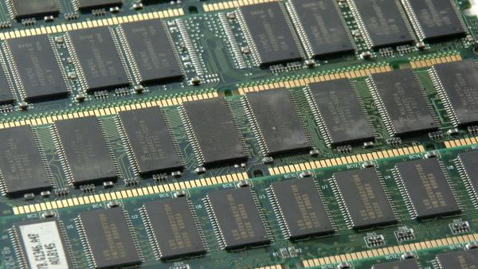
Computer & Arrays!

Slide 22
double dArr[4];

Slide 23
cout << dArr[X] ;
+X

Slide 24
dArr[0] = 3.7
+ 0
3.7

Slide 25
dArr[1] = 2
+ 1
3.7
2.0

Slide 26
dArr[2] = 5.5
+ 2
3.7
2.0
5.5

Slide 27
dArr[3] = 1.2
+ 3
3.7
2.0
5.5
1.2

Slide 28
dArr[4] = 300
+ 4
Crash
3.7
2.0
5.5
1.2

Slide 29
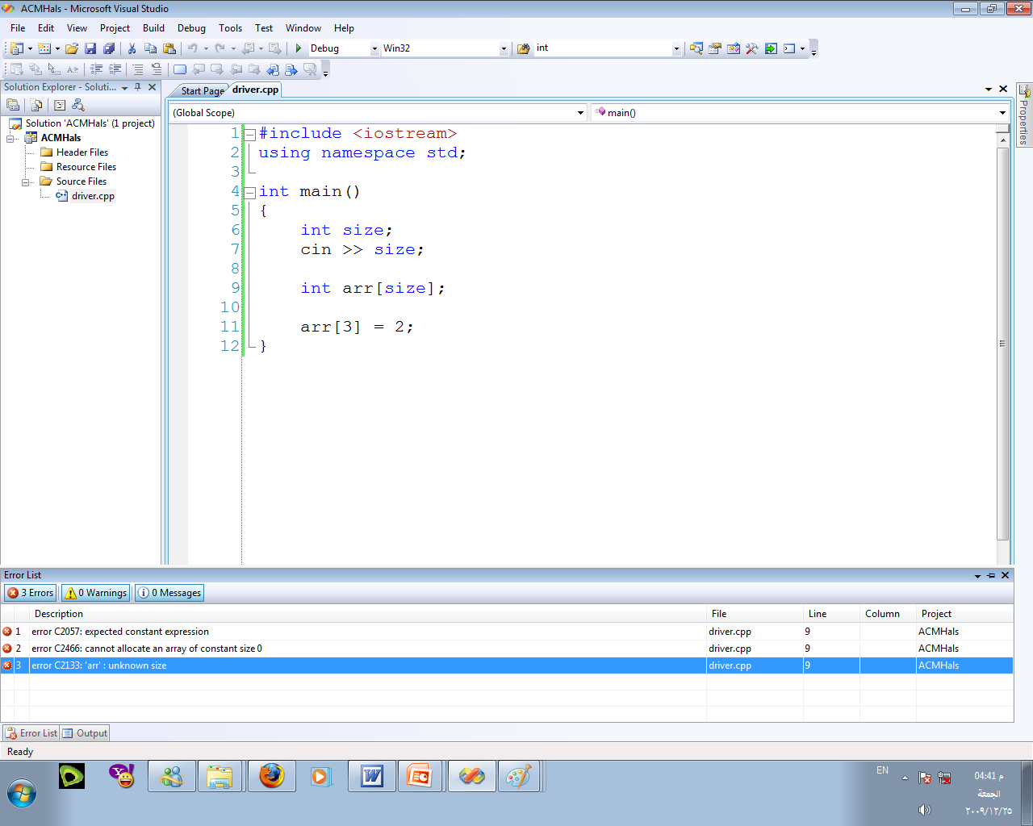
int main()
{
return 0;
}
int size;
cin >> size;
int arr[size];
arr[3] = 2;
Notes:
-- matego nshof el visual studio hay3mlha ezay ….

Slide 30
What about Array of Arrays ?…

Slide 31
CSTRING
is a char array

Slide 32
Declaration
int main()
{
}
char myCstring1[60];
// will fill with the null character '\0'
char myCstring2[]=“How are you?”;
char myCstring3[]={'H', 'e' , 'l' , 'l' , 'o' };
return 0;

Slide 33
Initialization
int main()
{
}
char myCstring1[60]; // will fill with the null character '\0'
char myCstring2[]=“How are you?”;
char myCstring3[]={'H', 'e' , 'l' , 'l' , 'o' };
return 0;
myCstring2[]
… | 'H' | 'o' | 'w' | ' ' | 'a' | 'r' | 'e' | ' ' | 'y' | 'o' | 'u' | '?' | '\0' | ….

Slide 34
Initialization (con.)
int main()
{
}
char myCstring1[60]; // will fill with the null character '\0'
char myCstring2[]=“How are you?”;
char myCstring3[]={'H', 'e' , 'l' , 'l' , 'o' };
return 0;
myCstring3[]
… | … | 'H' | 'e' | 'l' | 'l' | 'o' | '\0' | … | …

Slide 35
Let’s Play
with CSTRING!!

Slide 36
int main()
{
}
char word[10];
cin >> word;
int size= 0;
while (word[size] != '\0')
{
cout<<word[size];
size++;
}
cout<<endl;
return 0;

Slide 37
int main()
{
}
char word[10];
cin >> word;
int size= 0;
while (word[size] != '\0')
{
cout<<word[size];
size++;
}
cout<<endl;
return 0;

Slide 38
int main()
{
}
char word[10];
cin.get( word , 10);
int size= 0;
while (word[size] != '\0')
{
cout<<word[size];
size++;
}
cout<<endl;
return 0;

Slide 39
Helper Functions
for Cstring!!

Slide 40
#include <cstring>
- strlen(n);
// return the number of characters in array.
// n = name of the array.
- strcpy(X,Y);
// copy the characters in Y-array into X-array.
// x = the name of the copied array.
// y = the name of the original array

Slide 41
References
http://www.cplusplus.com/doc/tutorial/arrays/ //Arrays Tutorials
http://www.youtube.com/watch?v=ti0oiTL1Wuo //Arrays( video)
http://www.youtube.com/watch?v=gYB16A8NyB0 //Arrays( video)
http://www.youtube.com/watch?v=4yRYiiyTxCU //C-String ( video )

Slide 42
Challenge !!

Slide 43
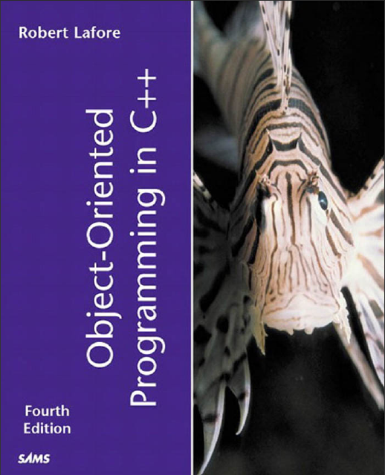
Download from here : http://iris.nyit.edu/~ffischma/oo_c++_1.pdf

